Slide 1
Essential Tools for Reproducible Research
Pipelines, Workflow Management Systems & Containers

Slide 2
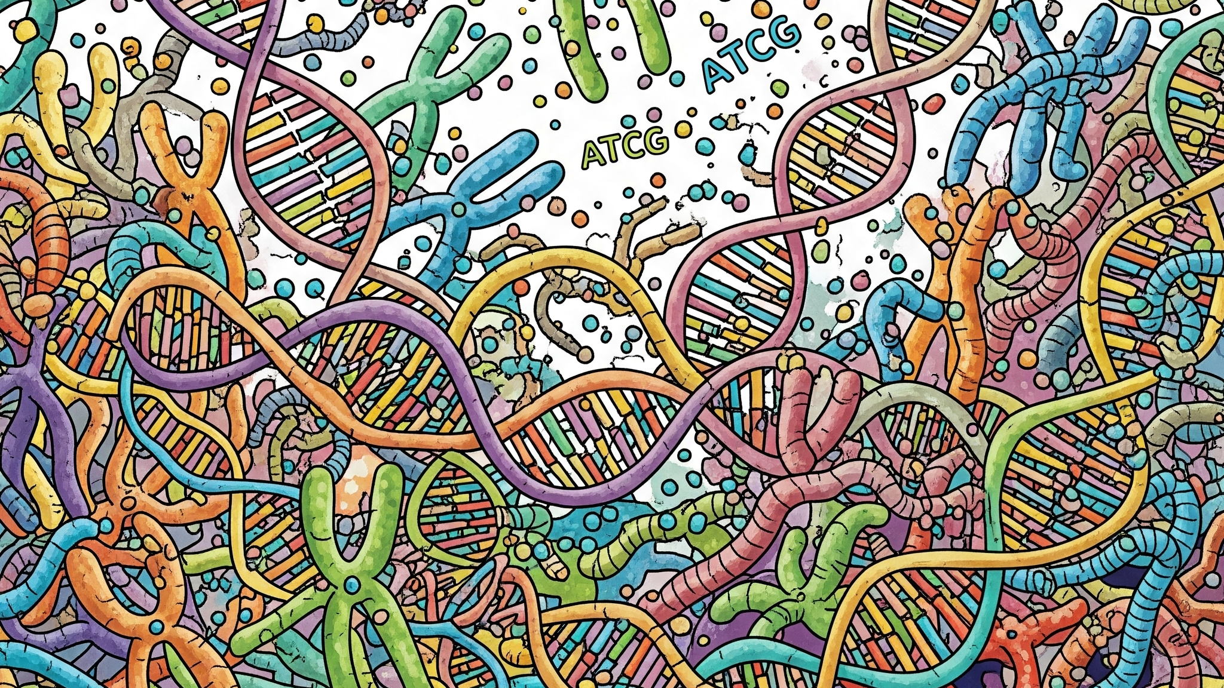
Notes:
You have a big mess of data

Slide 3
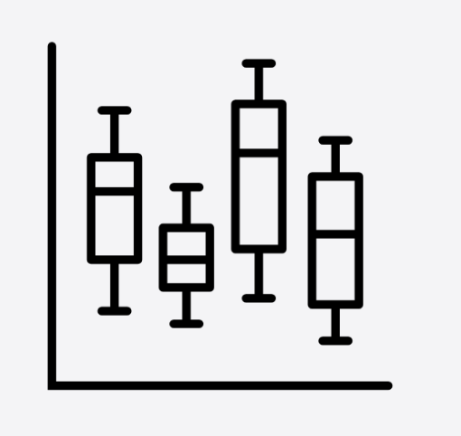
Notes:
You have a big mess of data

Slide 4
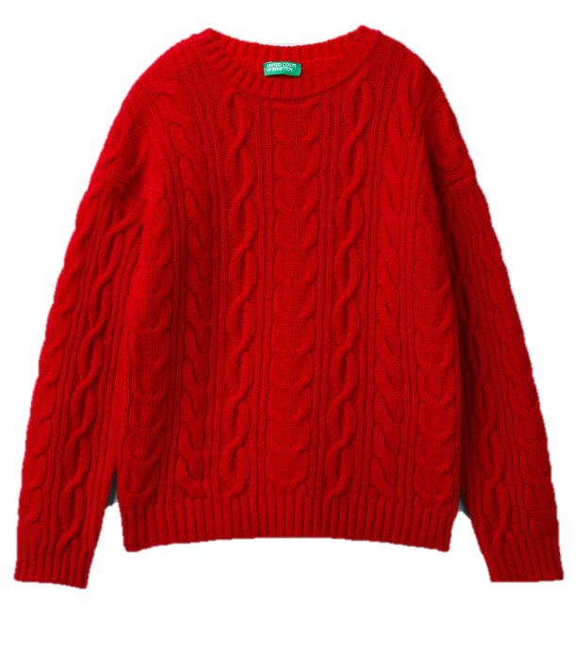

Slide 5

Notes:
The problem is that with this toolkit you can make a lot of different things

Slide 6

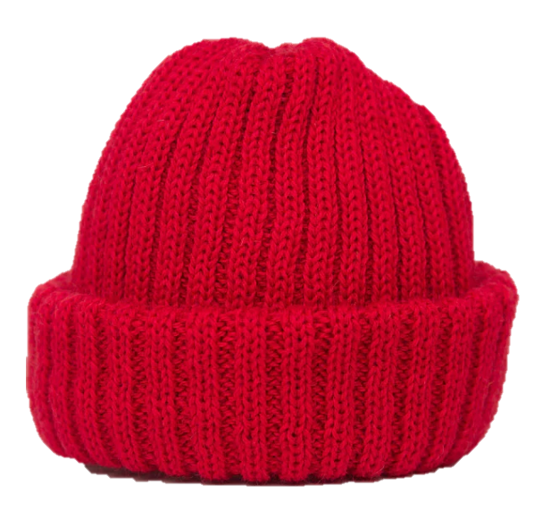

Slide 7
Notes:
How do you ensure you get this same result every time?

Slide 8
The Challenge in Bioinformatics Research
Bioinformatics analyses involve many distinct, often interdependent, computational steps.
Software versions, operating systems, and installed libraries can be inconsistent leading to different results.
"It worked on my machine!"
Notes:
How can we deal with these issues?
We haver already encountered these issues in this workshop.

Slide 9
So… what can we do?
Pipelines
Containers
Workflow Management Systems
Notes:
We have several tools that we can use to ensure that we will be able to recreate the exact same sweater every time

Slide 10
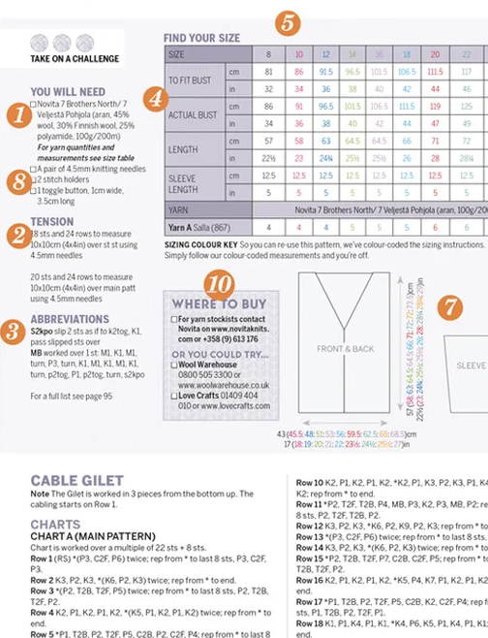
Pipelines - What & Why
A specific set programs or scripts to that is run in a predefined, automated sequence
Reduces manual errors, saves time, and provides detailed, step-by-step record of exactly what happened to your data.
How to knit a sweater
A ‘pattern’ for your analysis

Slide 11
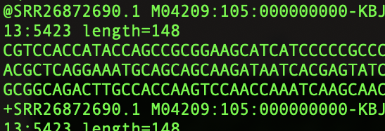
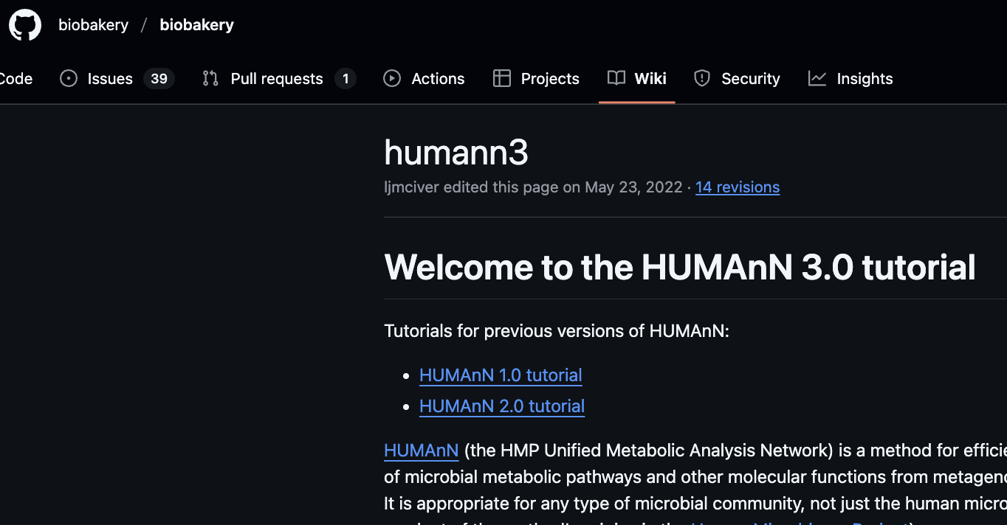

Example: Metagenomics Analysis
MetaPhlAn
Bowtie2
DIAMOND
Metagenomic Reads
Taxonomic Profiling
Pangenome Search
Translated Alignment
HUMAnN3
Pathway Reconstruction
Output
MinPath
https://huttenhower.sph.harvard.edu/humann/
Notes:
One of the many metagenomic pipelines
You have run a metagenomics pipeline yesterday. These usually consist of a combination of steps.
These pipelines contain different programs. All of which have different versions, dependencies et. Do you want to set and download all these manually every time you run the analysis? Room for error!

Slide 12
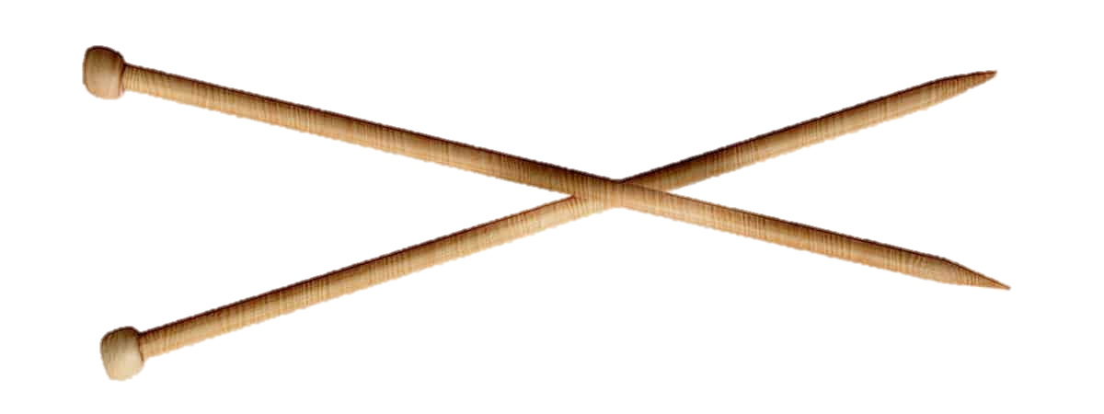

Containers – Keeping things constant
Self-contained, executable packages that bundle everything you to run whatever you want to run
Ensures your analysis runs identically, anywhere, anytime.
The ‘knitting kit’ of your analysis
Notes:
Containers are like your knitting kit

Slide 13


Our tools for making & managing containers
Docker: Most widely used platform for developing, shipping, and running applications in isolated containers.
Apptainer: Specifically designed for high-performance computing (HPC) and shared cluster environments.
https://www.docker.com/
https://apptainer.org/
Notes:
What can a container look like

Slide 14

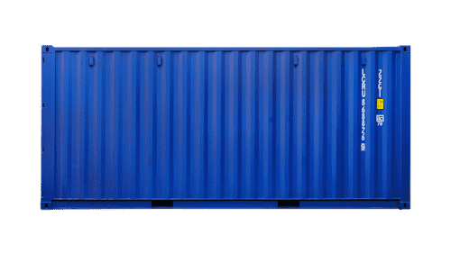
Elements:
Base Operating System: Ubuntu (Version 24.04 LTS)
R Interpreter: (R version 4.3.2)
R Packages: (ggplot2 version 3.4.4, dplyr version 1.1.4)
R Script: (my_analysis.R)
Filesystem: (the layered structure combining all elements above)
Notes:
Can include part of pipeline (single program to small pipeline or script)

Slide 15
How do we keep our pipelines and containers organized??

Slide 16

Workflows Management Systems
Software framework or engine that helps you build, manage, and execute pipelines (often within docker containers).
Handles dependencies, manages failures, and efficiently distributes computations across various resources.
Improves robustness, scalability, and overall project organization.
'Master Knitter’

Slide 17


Workflows Management Systems
Nextflow: - - - Highly scalable and portable pipelines, especially good for distributed computing on clusters or cloud platforms.
Notes:
So overall, I introduced you to three interconnected tools that we can use to make sure our input will ALWAYS give us the exact same output, regardless of where we run it!

Slide 18
Workflows Management System
Orchestrates the overall analysis strategy
Reproducible Results
Pipelines
Automated, sequential steps
Containers
Consistent and isolated environment
How to knit a sweater
+

